Slide 1
Hotel Industry Analysis
Shubham Sharma
Shubham Malpani
Sanjana Dubey
Greg Indick
Dawit Melke
Hanwen Shi

Slide 2
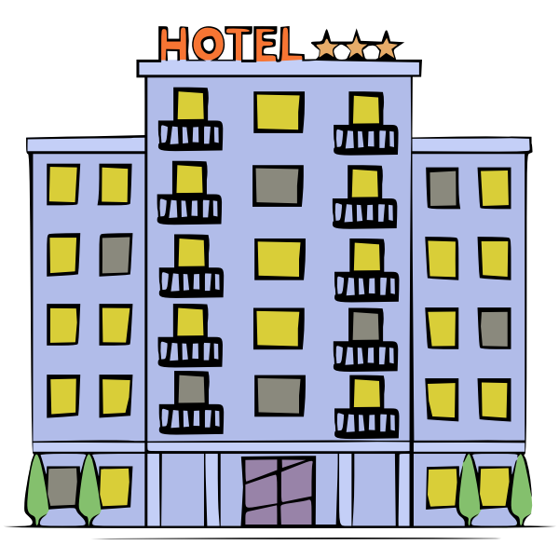
European Hotels group
Recently purchased by new owner who are not certain if current business strategy is working.
OUR GOAL is to help the European Hotels Group to
- Increase daily revenue
- Decrease cancelations

Slide 3
01
Initial Findings

Slide 4
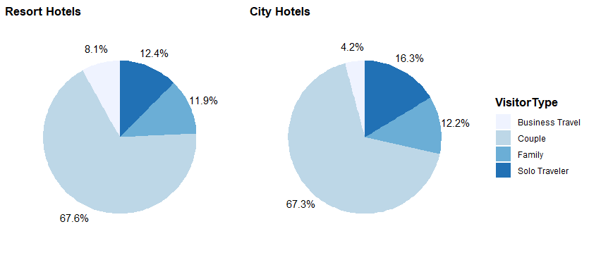
Bookings visitor wise
Over ⅔ of the customers were couples in both Cities and resorts.
Business Travelers usually travel to cities more.

Slide 5
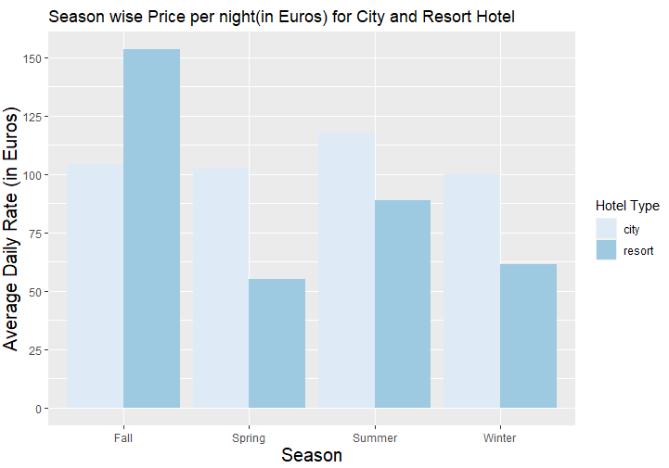
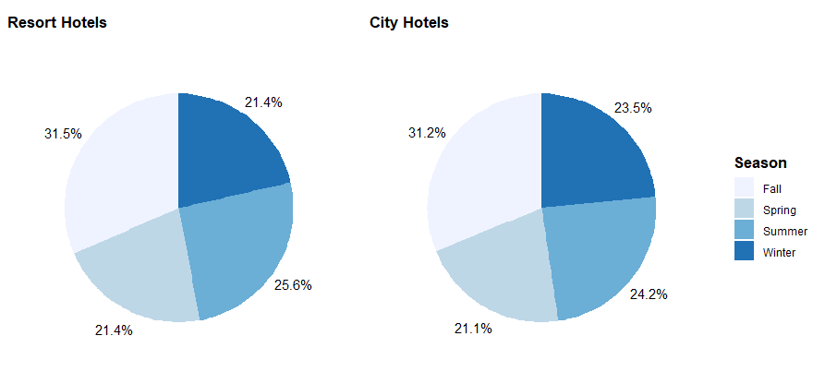
Season wise bookings and Price per night
Travelers frequented the two properties primarily in the fall.
In Fall season, ADR for Resort is higher than city but for other seasons, City hotels generate more revenue (per night).

Slide 6
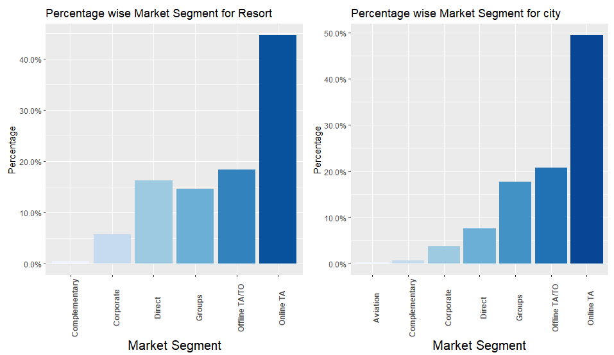
Market Segment
Travel agents dominate the bookings market.
Almost 50% of reservations were made through an online travel agent.
For Resorts, direct bookings are much higher as compared to cities.

Slide 7
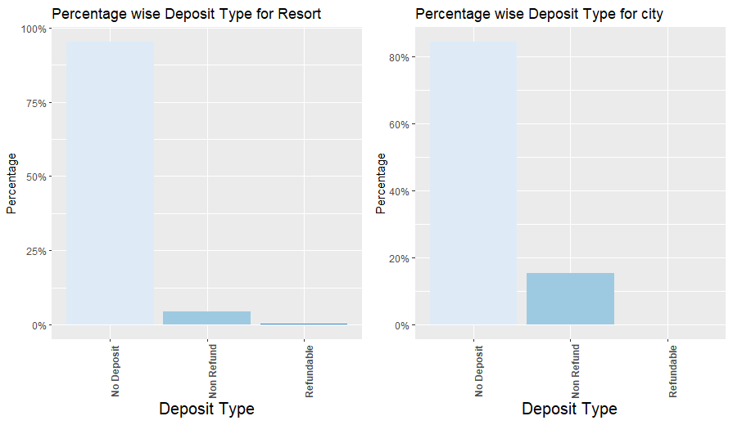
What kind of deposits do Customers make?
A large majority of reservations made no deposits whatsoever.
Hotels in cities do prefer Non-refundable deposits.
If deposits are made, they are generally non-refundable.

Slide 8
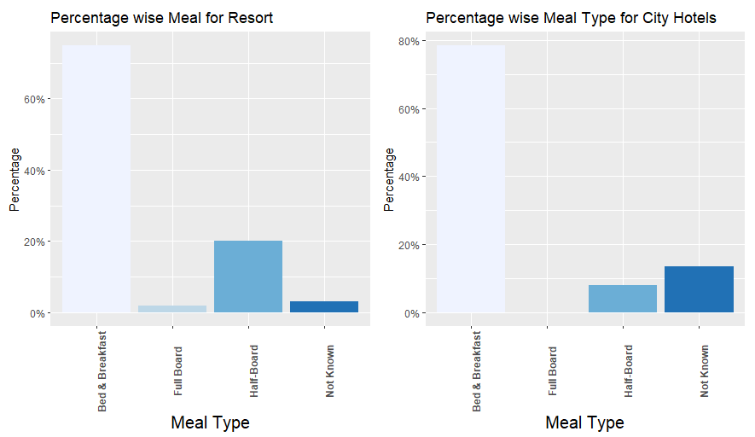
What type of Meal do visitors prefer?
A large majority of reservations made also were associated with bed & breakfast, while almost no customer got full board.
In resorts, people prefer to have at least Lunch/Dinner along with breakfast.

Slide 9
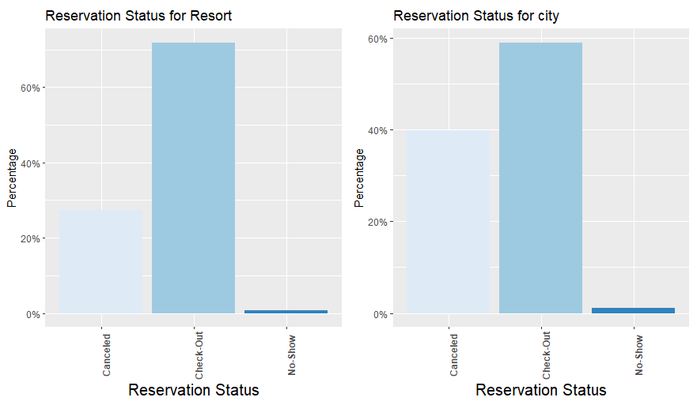
Reservation status of Visitors
Almost ⅔ of reservations were kept.
But cancellations also made up for 28% of the reservation's status.
Less than 2% of customers made reservations, but never showed up.
Cancellation Rate in cities is much higher than resorts.

Slide 10
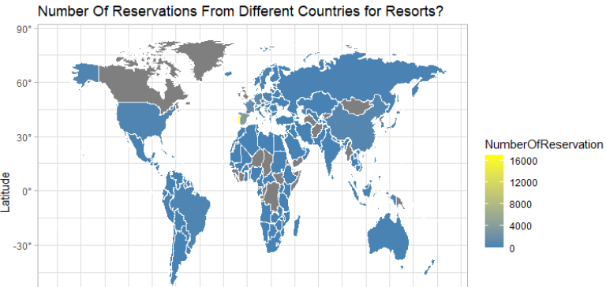
Where do people travel from?

Slide 11
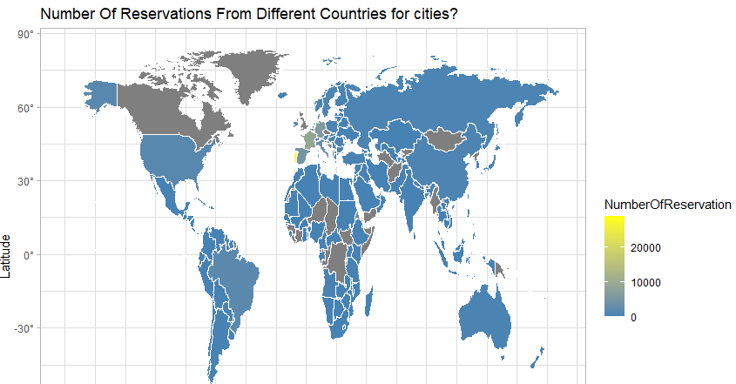
Majority of customers in both properties are from Portugal, followed by France, Germany and Spain.

Slide 12
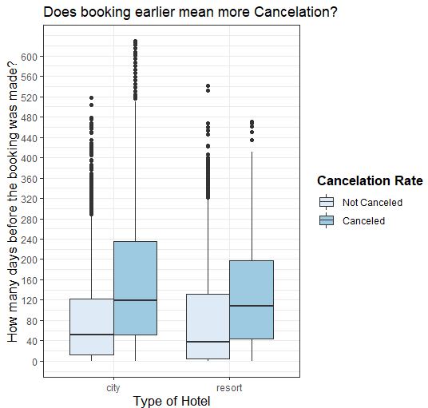
How early are people making their bookings and whether that affects confirmation?
In both resorts and City hotels, people who are booking more than 3 months ahead are likely to make a cancellation.
If a hotel is not canceled, lead time is usually around 30-40 days.

Slide 13
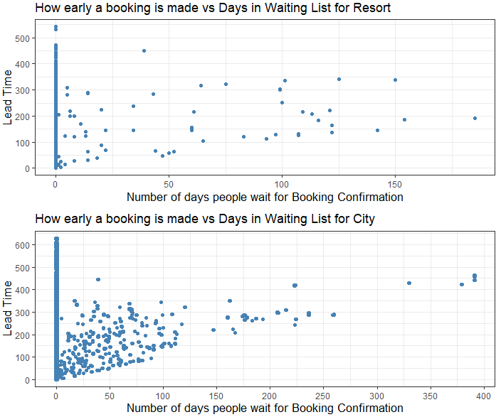
In resorts, waiting time is less and irrespective of how many months before the arrival people book, they get the reservation.
In city hotels, people might have to wait for some time for Booking confirmation but majorly, bookings are confirmed instantly.

Slide 14
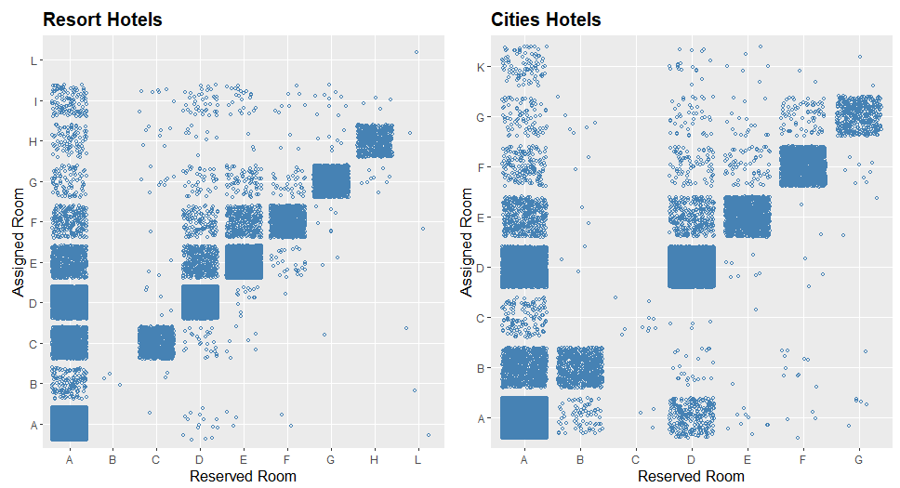
Are people being Assigned rooms that they Reserve?
Demand for Room type A is highest and when people book A, they get assigned other rooms as well in both types of hotels.
Demand for room B is very less in resorts while demand for room C is very less in Cities.

Slide 15
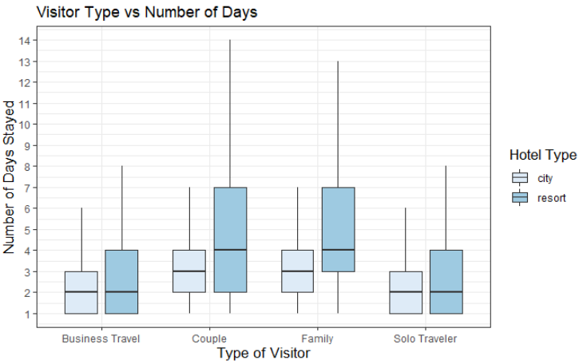
How many average days do people stay?
Couples and Families tend to stay twice as long as Business travelers and solo travelers in both type of hotels.

Slide 16
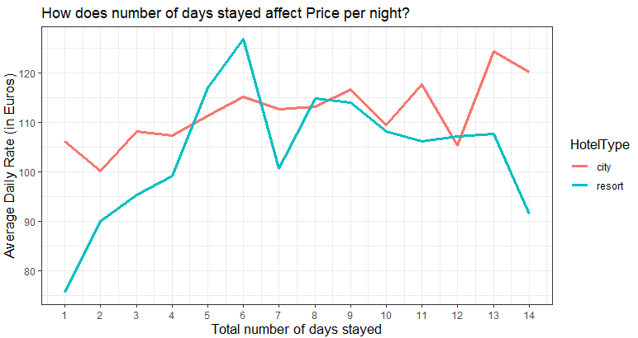
How does number of days stayed affect Price per night?
For City hotels, ADR isn’t affected much by total number of days.
For hotels, ADR increases by 10-20% every time the number of days increases.

Slide 17
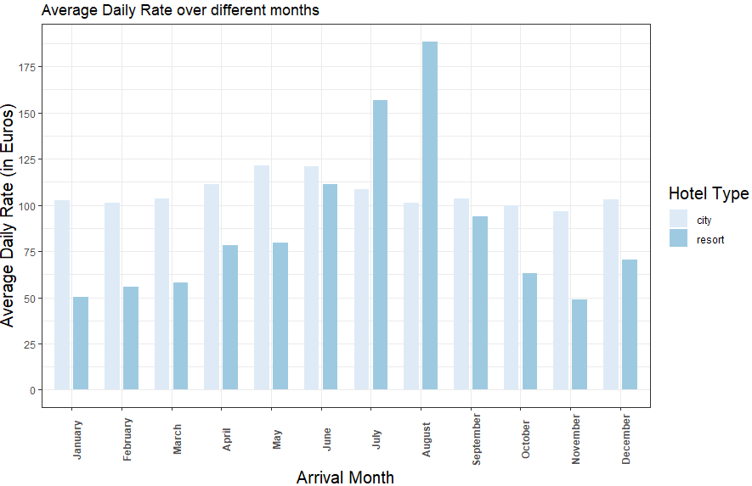
Month-wise Analysis
Most of the months, average daily rate for cities is higher than resorts.
Daily Rate for resorts shoot up in July and August.

Slide 18
Business questions
02

Slide 19

What can we learn from returning guests that can be applied to first time guests?

Slide 20
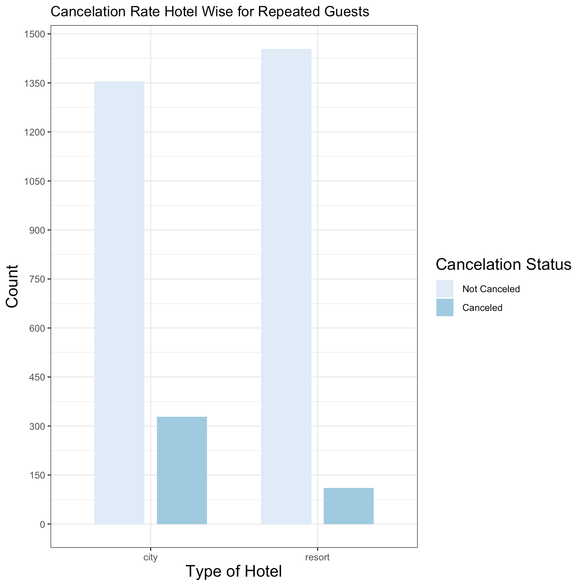
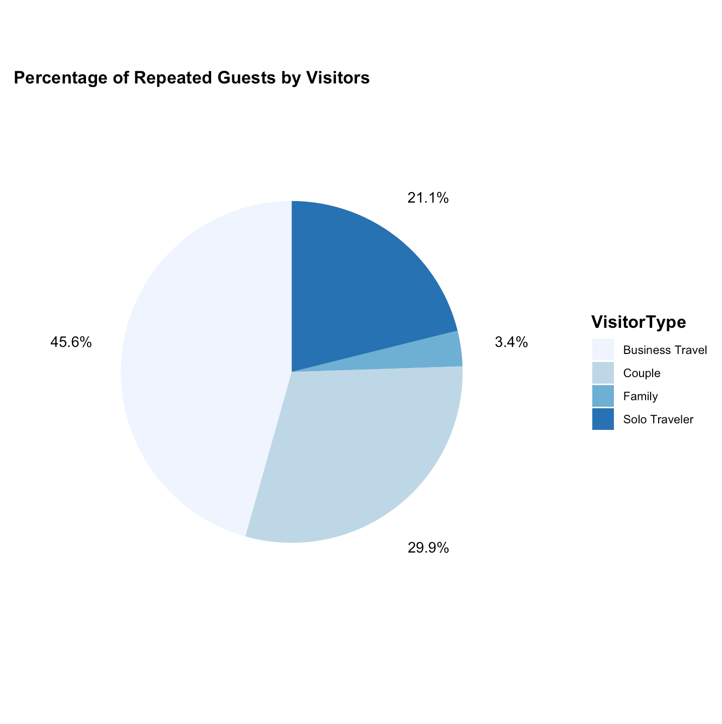
Plots

Slide 21
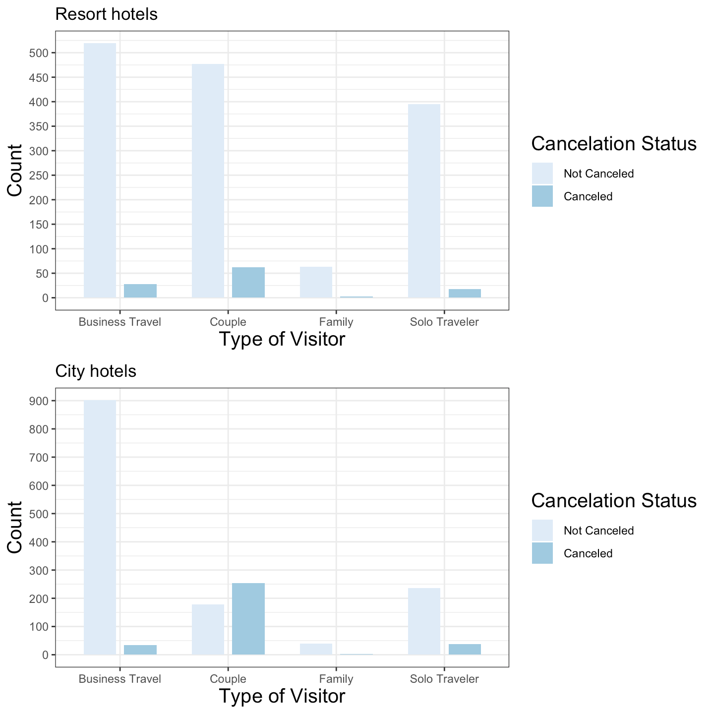
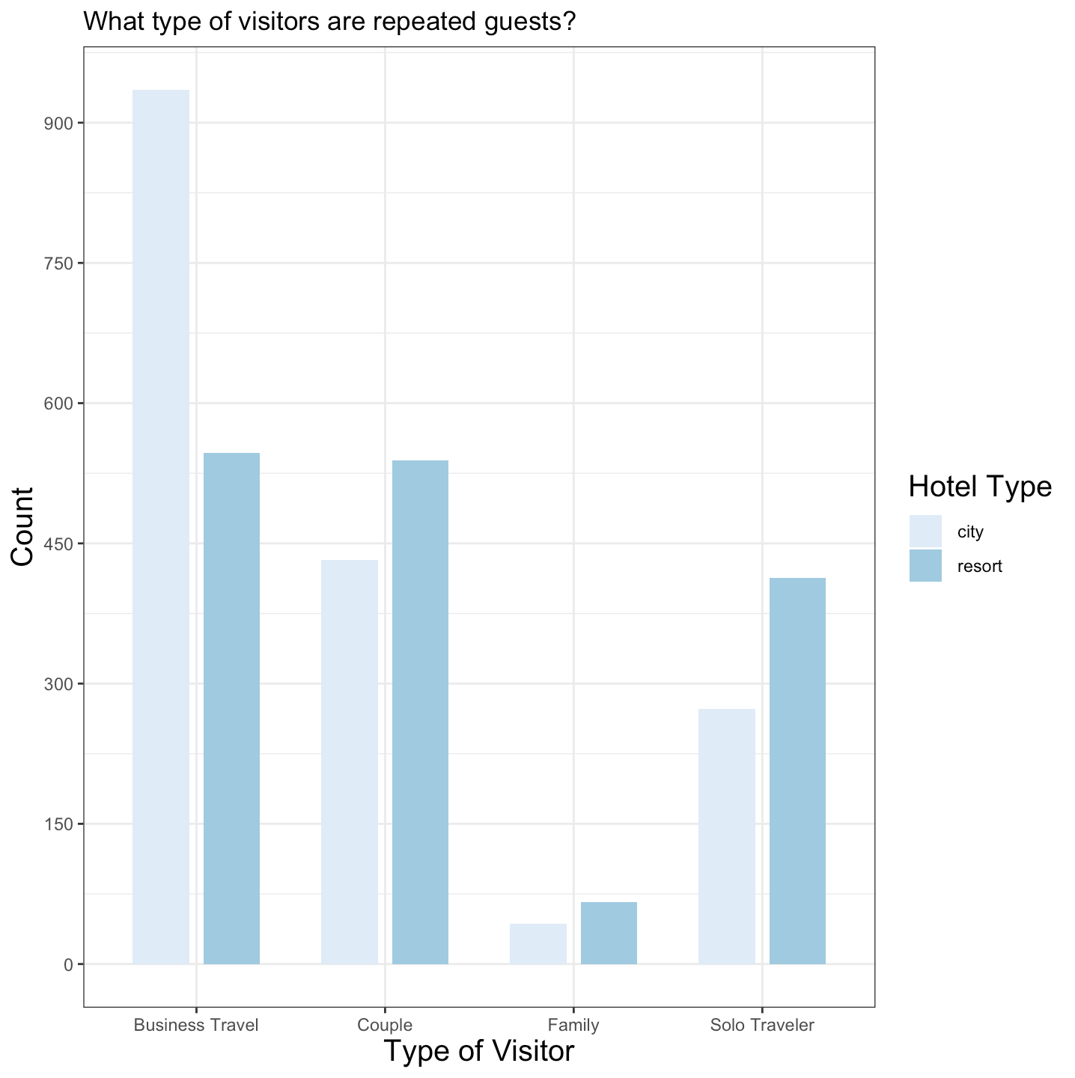
Plots

Slide 22
Findings
The most frequent type of repeating guests is Business Travel.
People are more likely to repeat their stay at the resort location compared to the city location, except for Business Travel.
A repeated guest is unlikely to cancel their stay at both the city and resort hotel.

Slide 23
Recommendations
Catering to a more corporate audience would be beneficial for your ADR
Perks like room upgrades after a certain number of stays, free dining experiences and reaching out to businesses so that their employees use your hotels when they are away on business trips.

Slide 24
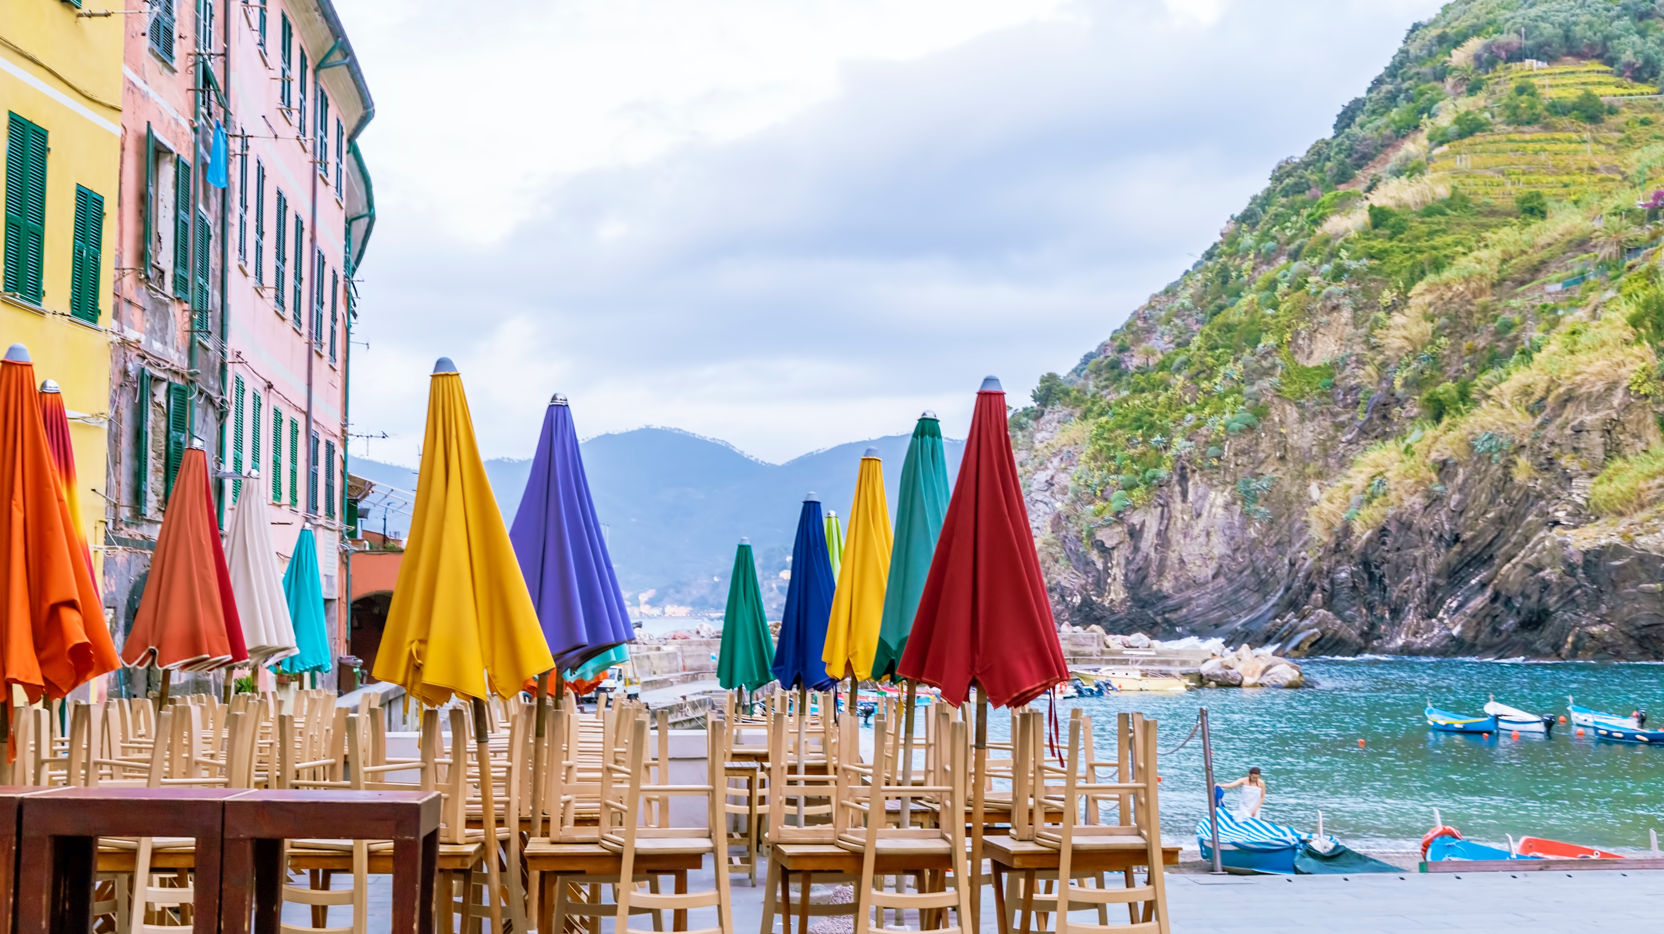
Which hotel had a better ADR? City or resort?

Slide 25
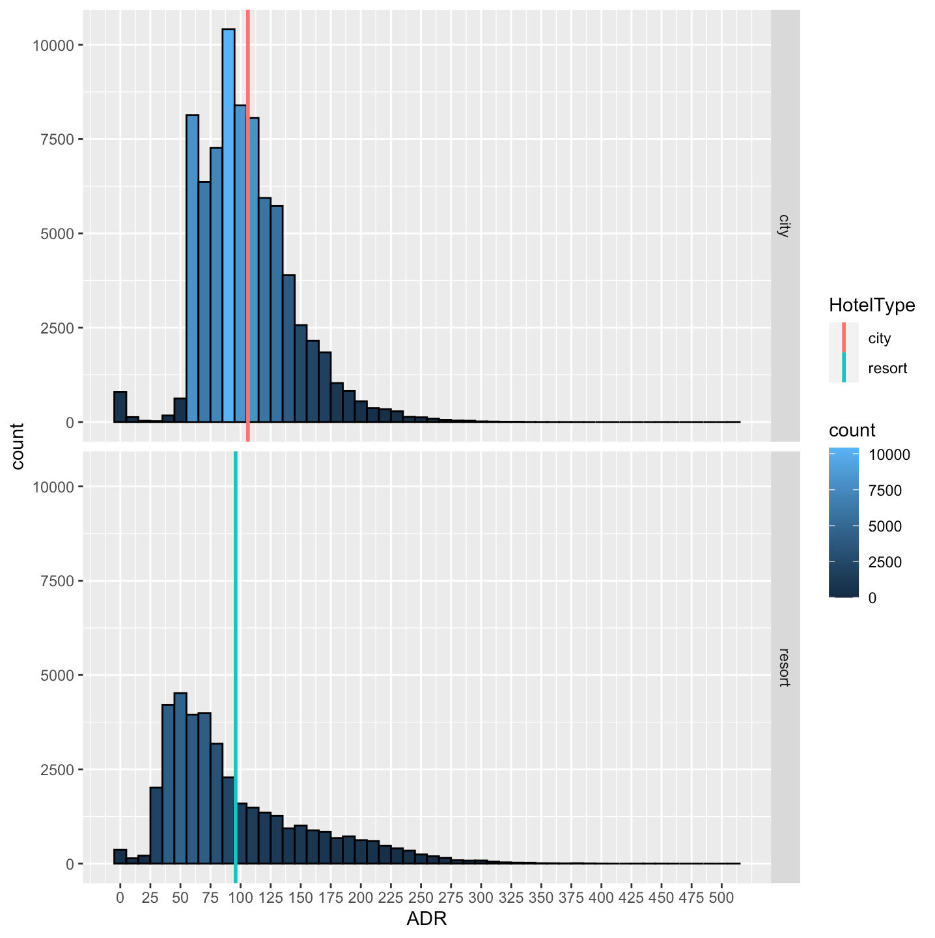
Findings
Even though city hotels have a higher reservation number, the mean overall is only slightly higher than that of resort hotels.
Average spending at city hotels is 90 - 125 Euros whereas that at resort hotels is 50 – 75.

Slide 26
Recommendations
Building more city hotels if you have the chance which will increase the revenue gained.
Even though the spending and ADR is more in city hotels, resorts can't be ignored.
Following our other recommendations, there will be an increase in the revenue if implemented on city hotels.

Slide 27

What visitor type has the most cancellations and lowest ADR, and how can we prevent that?

Slide 28
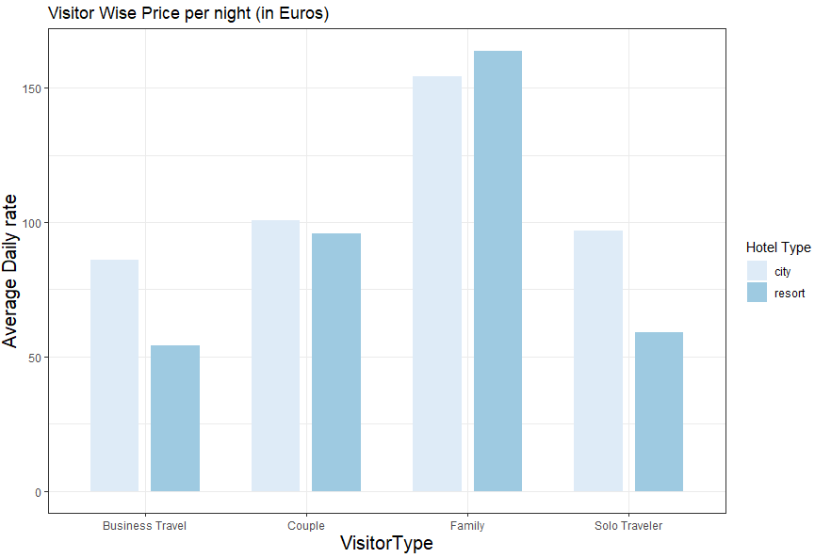
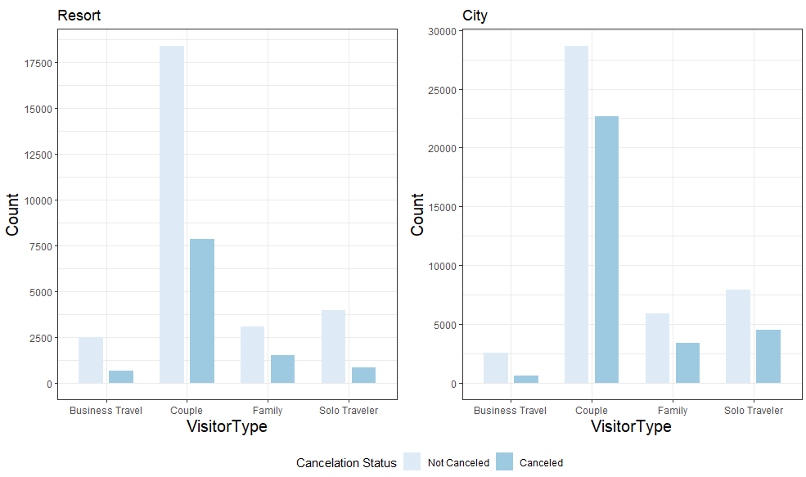
Couples make up most of the cancellations.
For Family and Couples, both types of Hotels generate similar revenue.

Slide 29
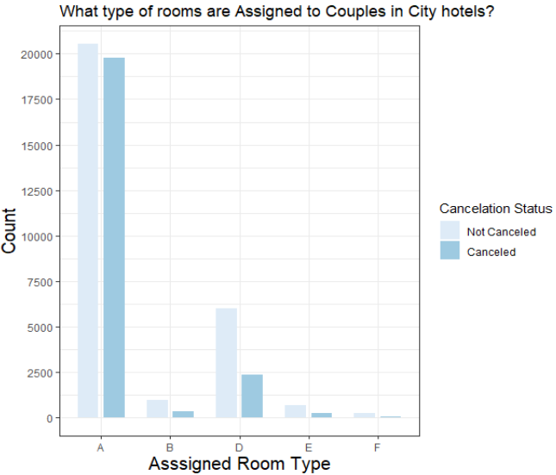
Cancellation rate is higher if couples get assigned room type A.

Slide 30
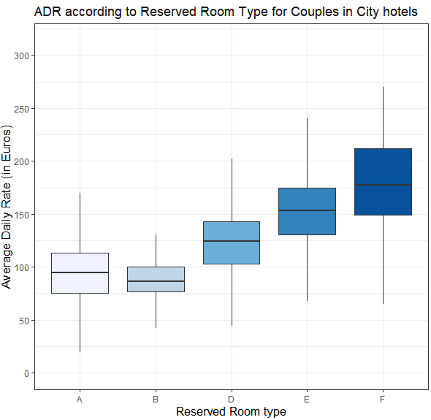
Recommendations
When verified as a couple a discount or a free meal upgrade could be given to them. Special focus should be on city hotels as the cancellation rate is higher than resort.
One more incentive could be upgrading the couples to the specific type of room when available decreasing the chances of cancelling.

Slide 31
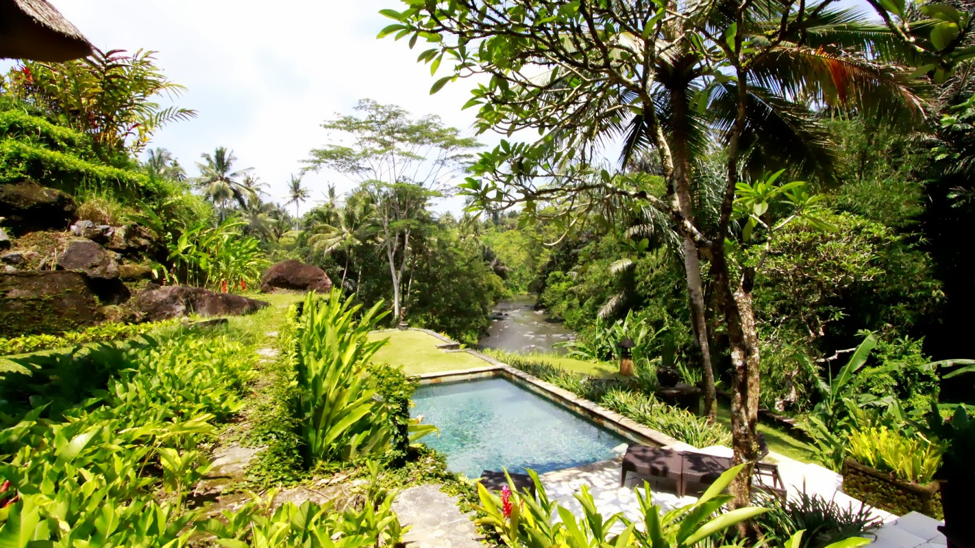
What Season has the most cancelation? How can we prevent other seasons from such?
This Photo by Unknown Author is licensed under CC BY-NC-ND

Slide 32
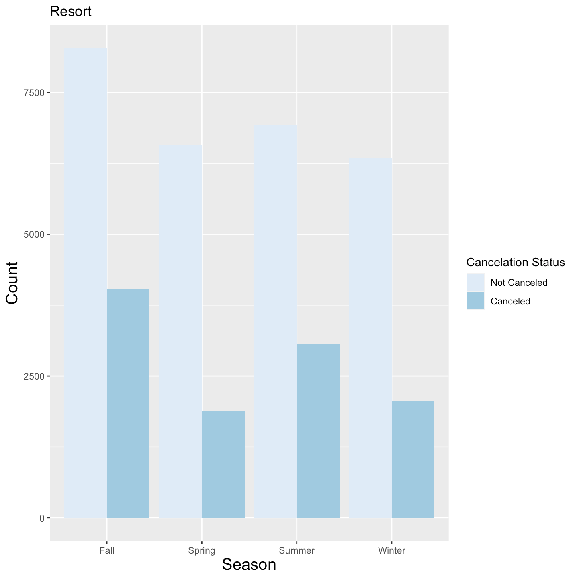
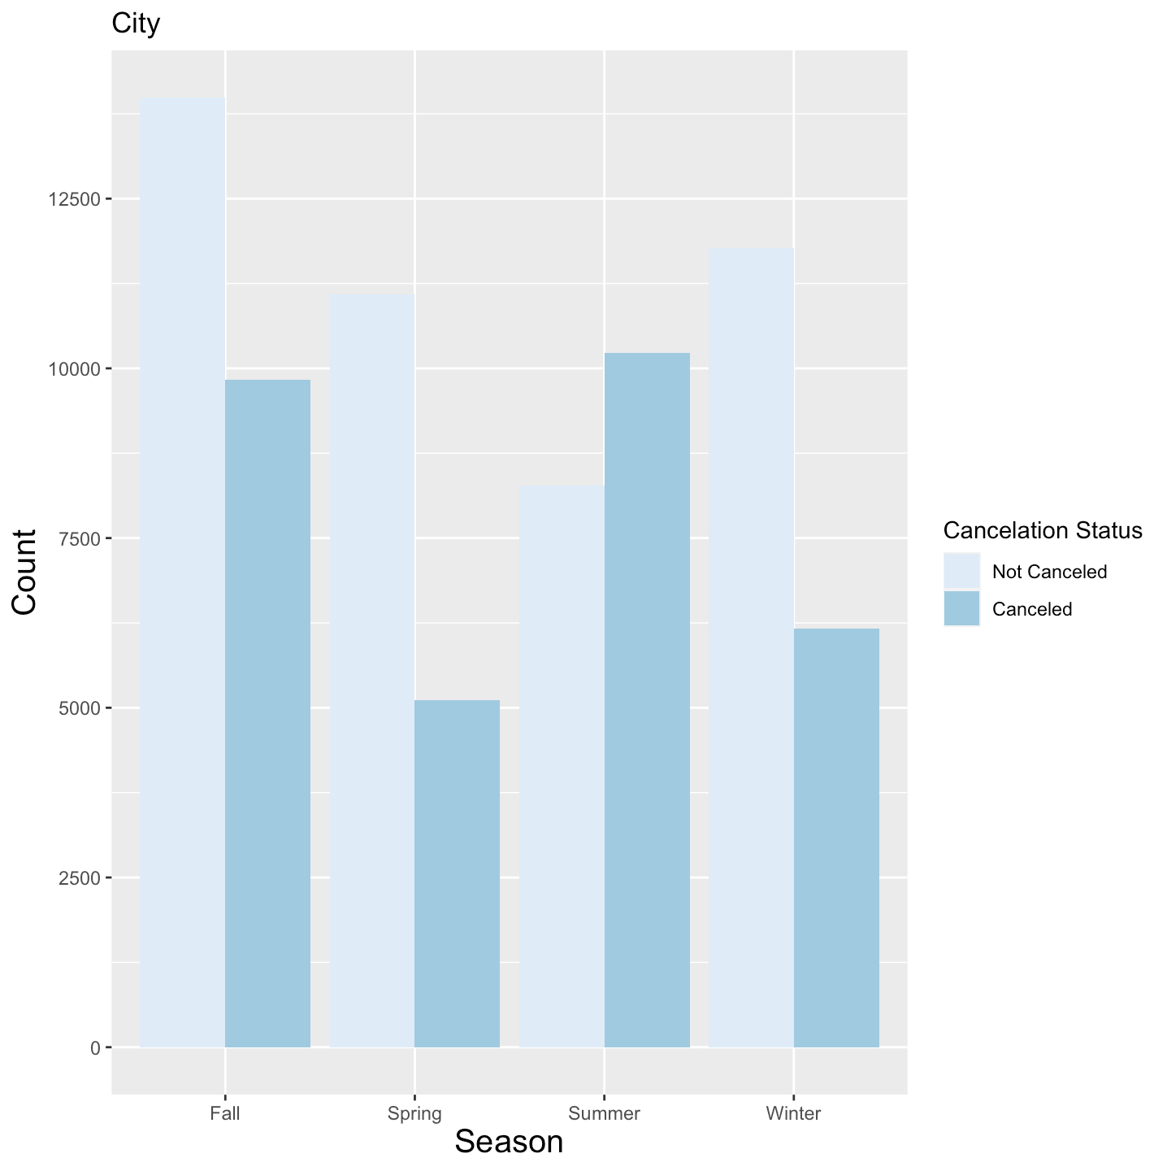
Plots

Slide 33
Findings
For the resort hotel fall has the maximum number of bookings followed by summer, spring and winter.
The maximum cancellations took place in the fall and spring months
The bookings months for the city hotels are the same as resort but the cancellation is way high in the summer season as compared to resort data.
In the city hotels the people who cancel during the summer months are way higher than the people booking.

Slide 34
Recommendations
Incentivize staying at city properties during the fall and summer season.
Providing local events and tourist attractions could keep their booking confirmed.
Finding season inspired activities to recommend to your guests is a great way to have them book and keep their reservation, increasing the ADR generated over these months.

Slide 35
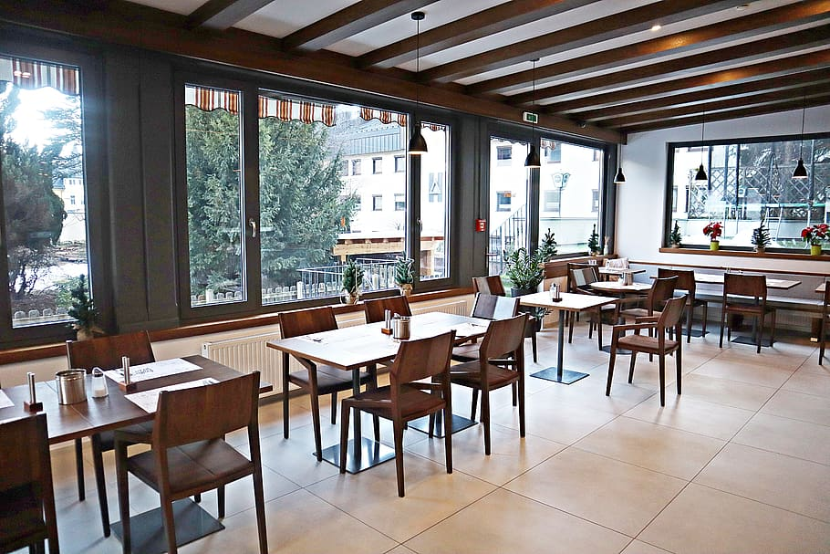
Any patterns of attributes that connect those who cancel their reservations?

Slide 36
Findings
City Hotel
The overall cancellation rate of city hotel is about 40%.
The cancellation rate for business travel is only about 50% of the overall cancellation rate.
The cancellation rate and cancellation numbers of couples are significantly higher than that of the other three types of visitors.

Slide 37
Findings
Resort Hotel
1. The overall cancellation rate of city hotel is about 30%. (less than city hotel)
2. For resort hotel, in addition to business travel, solo travelers also have a low cancellation rate for reservations.
3. The cancellation rate of family is the highest, about 17% higher than the overall cancellation rate.
4. The largest number of cancellations also comes from couples.

Slide 38
Plots
City Hotel
Resort Hotel
Arrtibute | Value
Meal | BB
Country | PRT
DistributionChannel | TA/TO
AssignedRoomType | A
ReservedRoomType | A
AnySpecialRequest | No
ParkingSpaceNeeded | No
IsRepeatedGuest | Not Repeated
Arrtibute | Value
CustomerType | Transient
Country | PRT
DistributionChannel | TA/TO
ParkingSpaceNeeded | No
IsRepeatedGuest | Not Repeated
Occurrence Rate > 20%
Occurrence Rate > 15%
Cancellation Rate > 90%
Cancellation Rate > 60%

Slide 39
Recommendations
Business travel can pay a low or no deposit when booking. Single travelers can also have this offer in resort hotel.
Couples are required to pay a higher deposit when booking to guarantee that the reservation will not be cancelled. Families are also required to guarantee the reservation through a deposit in resort hotel.
For reservations from couples with the above characteristics, both hotels can request the non-refundable deposit type.
Such a flexible deposit strategy can reduce cancellation rates by charging different amounts and different types of deposits depending on the type of visitors.

Slide 40
How can we predict cancelations in order to make sure customers keep reservations?

Slide 41
Factors affecting cancellations
1. Lead Time: It is directly proportional to the probability of cancellation.
2. Days in Waiting List: The more the number of days assigned to customers in waiting list, the more likely they'll look for better options elsewhere.
3. Previous Cancellations/Previous Bookings not cancelled: If the customer has cancelled with the hotel before they are more likely to cancel again.
4. Booking Changes: More changes while booking shows indecisiveness of the customer and hence makes them unreliable for the bookings made
5. Total number of special requests: Customers with a list of special requests are generally found to be particular about amenities and services at the hotel and if not fulfilled immediately, probably would lead to cancellation

Slide 42
Predicting Future Cancellations
Based on our analysis, we created models to predict the future cancellations.
Based on the incoming data, our model has 74% percent chances of correctly predicting whether the customer will cancel in the future.

Slide 43
Conclusions
04

Slide 44
KEY FINDINGS
ADR is higher in City hotels than resort hotels.
Business Travelers are more likely to repeat themselves in City hotels while Couples and Family are likely to be repeated guests in Resort hotels.
Couples are highly likely to cancel a city hotel during summer.
Solo Travelers are likely to cancel a City Hotel more than a Resort hotel.

Slide 45
KEY RECOMMENDATIONS
Couples in cities should be assigned Room Type D, E and F for increasing ADR.
For resorts, most of the visitors prefer Weekend Stays and they prefer City Hotels for weekdays.
Instead of Bed and Breakfast, city hotels can upgrade the meal to Half Board for Couples by giving some discounts.
Visitors should be allowed to book a City Hotel no more than 3 months of their planned trip.

Slide 46
Do you have any questions?
THANKS

